Slide 1

E-retail factors for customer activation and retention: A case study from Indian e-commerce customers
PREPARED BY:
IFATH FATIMA

Slide 2
CUSTOMER RETENTION:
Customer retention is the ability of a company to retain its customers over a specified period. If a company has high customer retention, that means its customers continue to rebuy the same products, to resubscribe to the same services or, in some other way, continue buying from that company.
Customer retention is vital for two reasons: First, even if you are adding new business, you can’t grow your company if you are simultaneously losing business. The second reason is incredibly black and white: It’s always more expensive to acquire a new customer than it is to keep your current customers and sell more to them.

Slide 3
PROBLEM STATEMENT
Factors determining customer satisfaction have been brought to light by marketing research.
But, this information still is far away for some producers engaging in the productions and services. Even though, immense of information available in the marketing environment, their success will be reached only when acting upon them.
The following question regarding customer satisfaction and loyalty.
1. What are main factors determining the customer loyalty?.
2. Is there any relationship between customer satisfaction and loyalty?.

Slide 4
OBJECTIVE
In line with the issues identified above, the main purpose of the study is to examine the
relationship between customer satisfaction and loyalty.
In order to materialize this broad objective, the following sub objectives have been considered.
1. To find out the variables determining customer satisfactions.
2. To focus on the variables determining the loyalty.
3. To identify the impacts of customer satisfaction and loyalty.

Slide 5
BUILDING GOOD CUSTOMER RETENTION PROGRAMS
Building a customer loyalty program such as a rewards program or a referral program may be a good option for some D2C retail-focused businesses. They can reward your most loyal customers for making a repeat purchase and increase your word-of-mouth referrals, which are often some of your best-qualified leads.
Loyalty programs
Most loyalty programs award purchase points, which can be redeemed for discount coupons or other products. Brands like Sephora have demonstrated that loyalty programs can dramatically promote customer retention. Loyalty programs cultivate repeat business and customer referrals. There’s no sales tool more effective than the social proof of a personal recommendation.

Slide 6
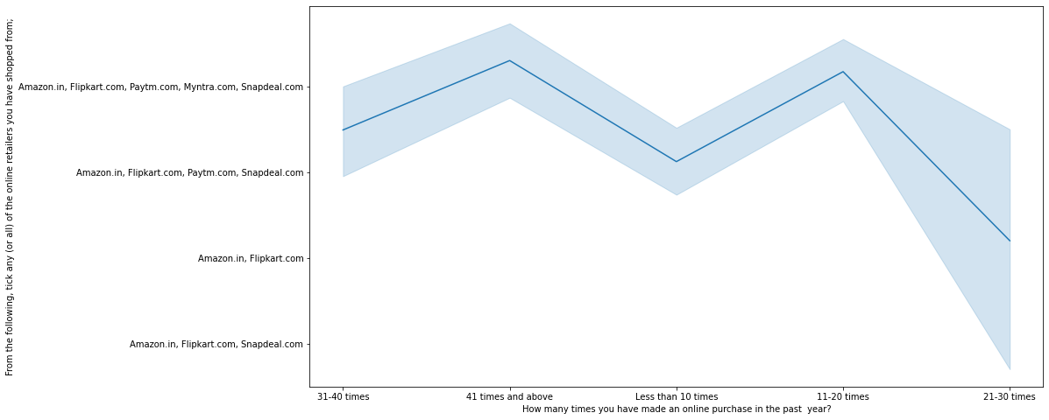
Analysis on the basis of Various following factors:
How many times you have made an online purchase in the past year?
Heavy shoppers who shop more than 41 times a year shop from all the online brands, some of the people who shop for 32-40 and less than 10 times a year seem to exclude myntra. People shop from Amazon and flipkart whatever be the case.

Slide 7
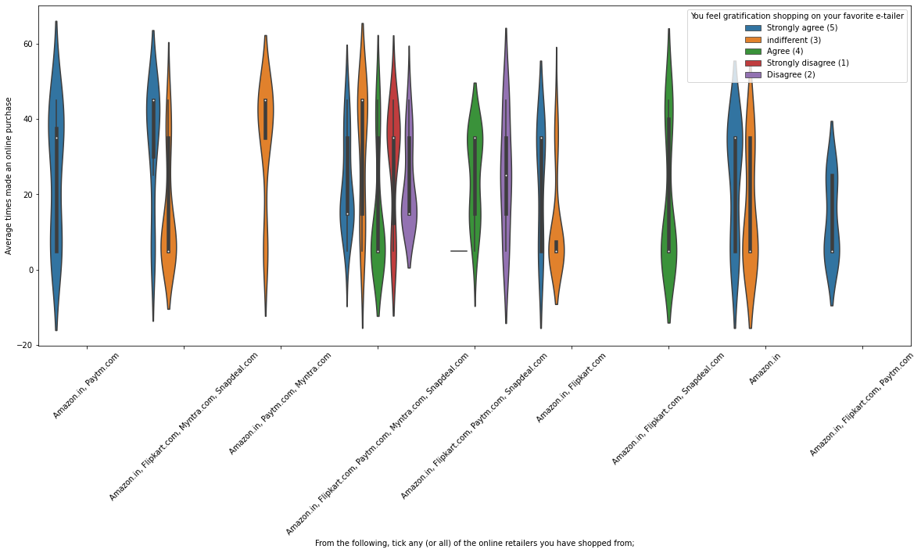
From the following,tick any(or all) of the online retailers you have shopped from.
Almost all the people who have shopped from amazon, flipkart and paytm are satisfied. People who shop from a more number of online brands dosen’t seem to be satisfied.

Slide 8
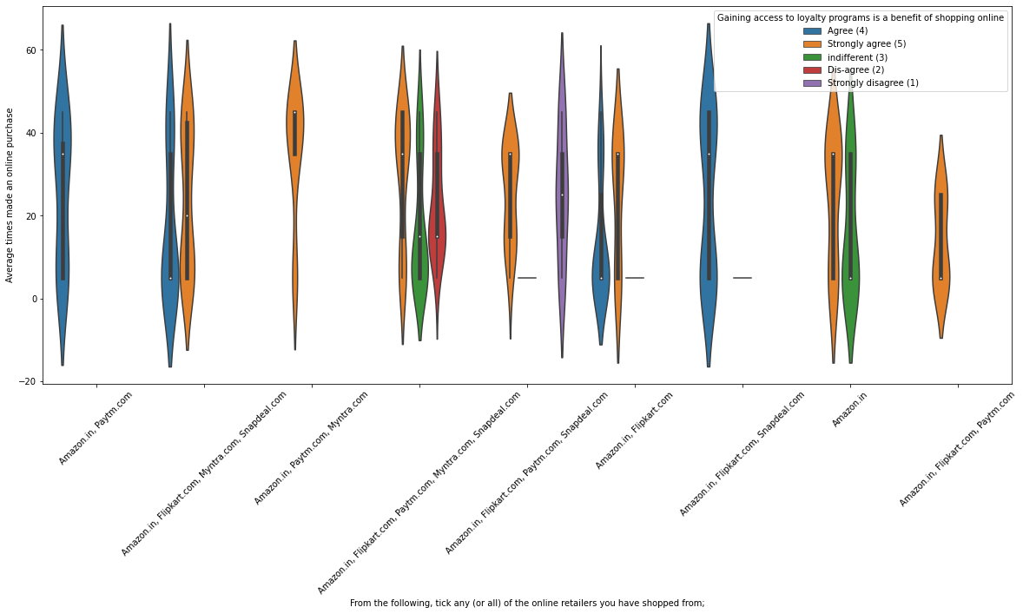
From the following, tick any(or all) of the online retailers you have shopped from.
People shopping from amazon and paytm are getting benefits from the loyalty points, flipkart and sanpdeal also seem to give such benefits but people who shop from almost everywhere disagree with this statement too.

Slide 9
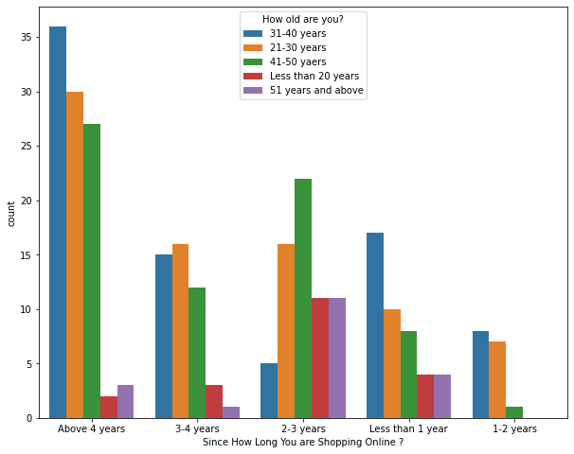
Since how long you are shopping? How old are you?
Highest number of people have been shopping online for above 4 years except for the age group below 20 years and above 50 years. People who are shopping online for 1-2 years does not include teenagers and elder people.

Slide 10
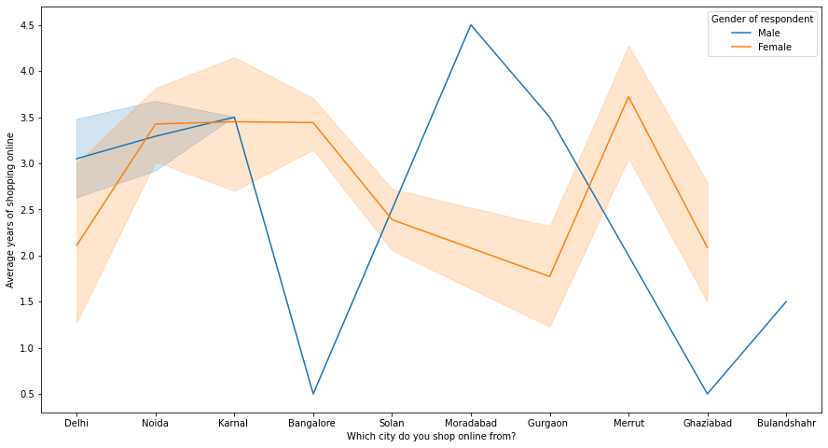
Which city do you shop online from?
In lines, we can see that density of female customers is more than male. Men living in banglore and ghaziabad shop have shopped online for less than 1 year. Highest number of men shopping online belong from delhi and noida, while men from moradabad have been shopping online for the longest. Women from meerut and noida have shopped the longest.

Slide 11
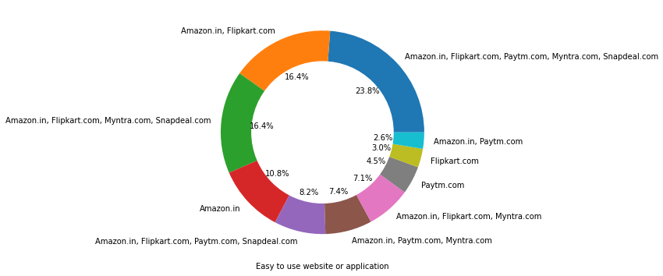
Brand Image
Performance:
Easy to use website or application?

Slide 12
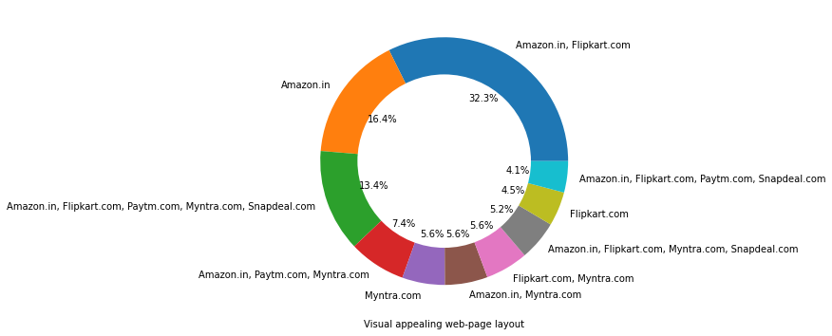
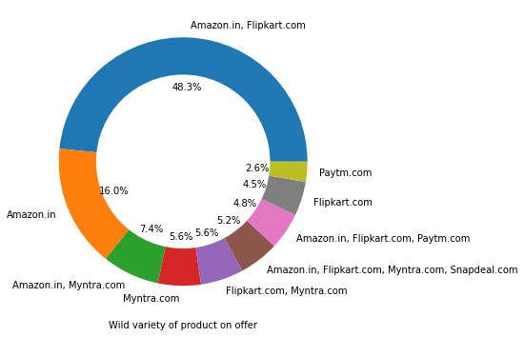
Visual appealing web-page layout', 'Wild variety of product on offer'

Slide 13
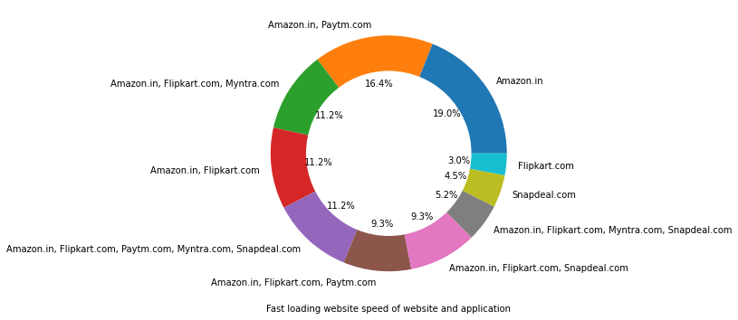
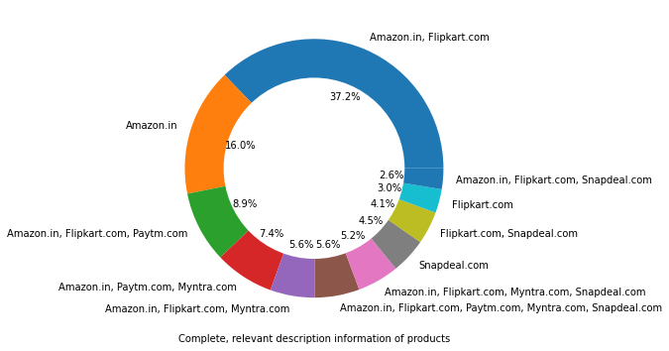
Complete, relevant description information of products,
Fast loading website speed of website and application

Slide 14
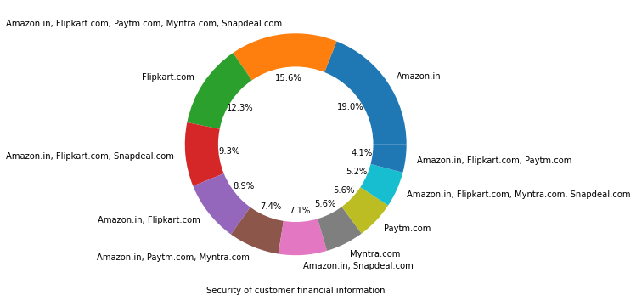
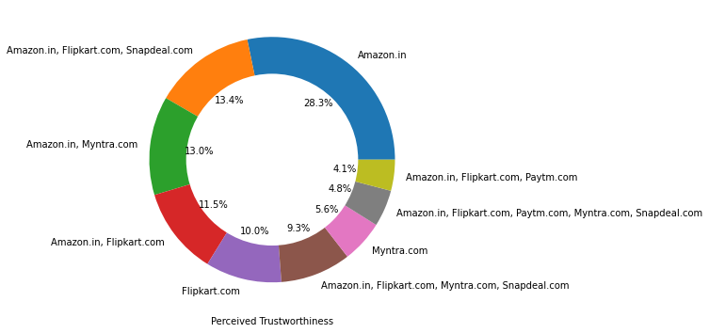
Security of customer financial information,
Perceived Trustworthiness.

Slide 15
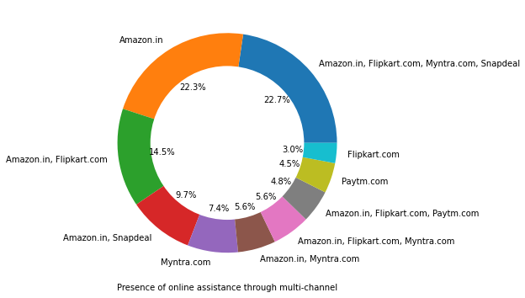
Presence of online assistance through multi-channel
Amazon, Flipkart have been had the highest votes for having all the positive points and have maintained a very good brand image followed by paytm and the myntra.

Slide 16
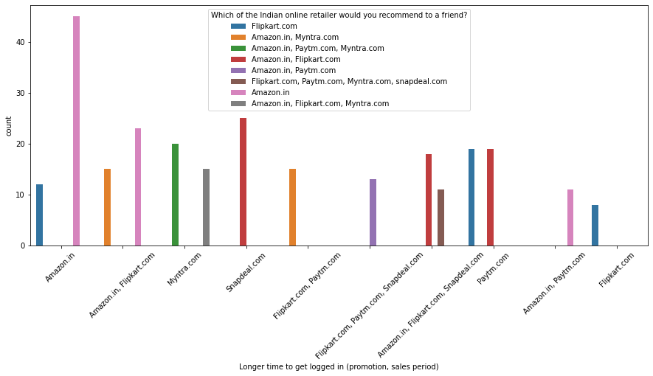
LOYALTY:
Loyal customers are those who keep using the same brand even if it is not good as other brands.
Which of the Indian online retailer would you recommend to a friend?

Slide 17
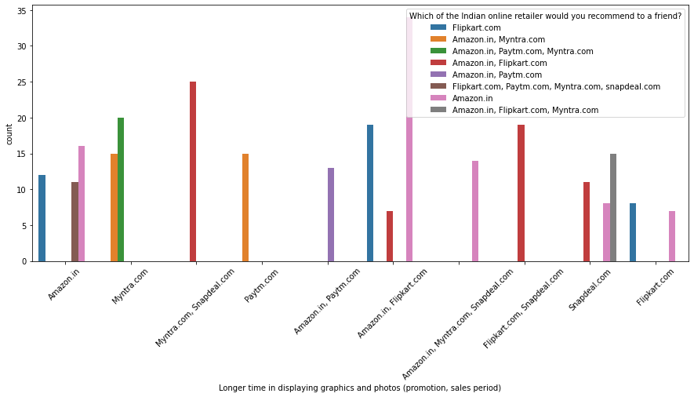
Longer time in displaying graphics and photos (promotion, sales period)

Slide 18
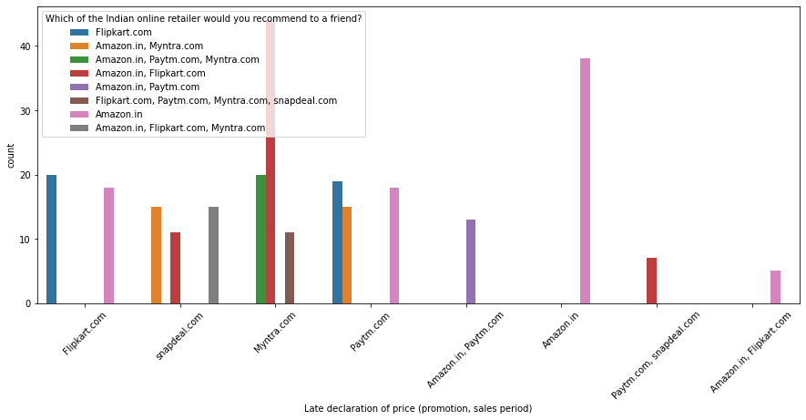
Late declaration of price (promotion, sales period)

Slide 19
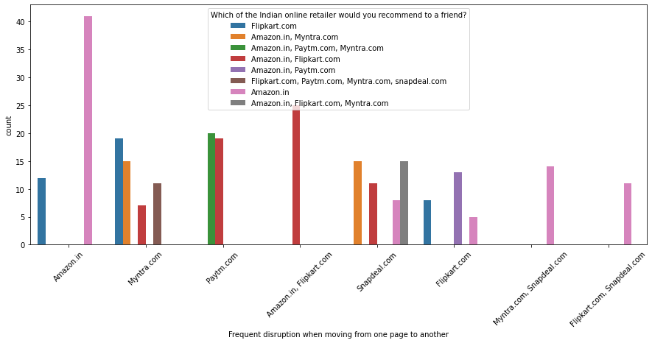
Frequent disruption when moving from one page to another
Customers seem to be more loyal to amazon, flipkart and paytm as even though many of them have given negative remarks about them still they would recommend these platforms to their friend.

Slide 20
Principal Component Analysis (PCA) is a statistical procedure that uses an orthogonal transformation that converts a set of correlated variables to a set of uncorrelated variables. PCA is the most widely used tool in exploratory data analysis and in machine learning for predictive models.
PCA:
fig, ax = plt.subplots(figsize=(20,10))
xi = np.arange(1, 73, step=1)
yi = np.cumsum(pca.explained_variance_ratio_)
plt.ylim(0.0,1.1)
plt.plot(xi, yi, marker='o', linestyle='--', color='b')
plt.xlabel('Number of Components')
plt.xticks(np.arange(0, 72, step=1)) #change from 0-based array index to 1-based human-readable label
plt.ylabel('Cumulative variance (%)')
plt.title('The number of components needed to explain variance')
plt.axhline(y=1, color='r', linestyle='-')
plt.text(0.5, 0.85, '100% cut-off threshold', color = 'red', fontsize=16)
ax.grid(axis='x')
plt.show()

Slide 21
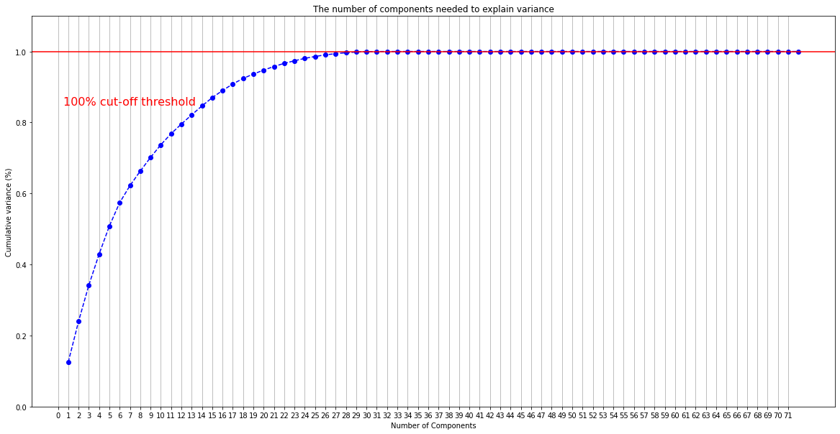
RESULT:
We can clearly see that with 29 features all the information can be retained.

Slide 22

Modelling:
Random Forest
Xgboost
Hyperparameter Tuning:
Random Forest
params={'n_estimators':[100, 300, 500, 700],
'min_samples_split':[1,2,3,4],
'min_samples_leaf':[1,2,3,4], 'max_depth':[None,1,2,3,4,5,6,7,8,9,10,15,20,25,30,35,40]}

Slide 23
Accuracy 1.0 ---------------------------------------------------------- Mean of Cross Validation Score 0.9926 ---------------------------------------------------------- Confusion Matrix [[26 0 0 0 0 0 0 0] [ 0 22 0 0 0 0 0 0] [ 0 0 4 0 0 0 0 0] [ 0 0 0 4 0 0 0 0] [ 0 0 0 0 5 0 0 0] [ 0 0 0 0 0 7 0 0] [ 0 0 0 0 0 0 11 0] [ 0 0 0 0 0 0 0 2]] ---------------------------------------------------------- Classification Report precision recall f1-score support 0 1.00 1.00 1.00 26 1 1.00 1.00 1.00 22 2 1.00 1.00 1.00 4 3 1.00 1.00 1.00 4 4 1.00 1.00 1.00 5 5 1.00 1.00 1.00 7 6 1.00 1.00 1.00 11 7 1.00 1.00 1.00 2 accuracy 1.00 81 macro avg 1.00 1.00 1.00 81 weighted avg 1.00 1.00 1.00 81
print('Accuracy',np.round(accuracy_score(p,ytest),4))
print('Mean of Cross Validation Score',np.round(s.mean(),4))
print('Confusion Matrix')
print(confusion_matrix(p,ytest))
print('Classification Report')
print(classification_report(p,ytest))
Output:
Accuracy 1.0
----------------------------------------------------------
Mean of Cross Validation Score 0.9926
----------------------------------------------------------

Slide 24
Confusion Matrix
[[26 0 0 0 0 0 0 0]
[ 0 22 0 0 0 0 0 0]
[ 0 0 4 0 0 0 0 0]
[ 0 0 0 4 0 0 0 0]
[ 0 0 0 0 5 0 0 0]
[ 0 0 0 0 0 7 0 0]
[ 0 0 0 0 0 0 11 0]
[ 0 0 0 0 0 0 0 2]]
----------------------------------------------------------
Classification Report
precision recall f1-score support
0 1.00 1.00 1.00 26
1 1.00 1.00 1.00 22
2 1.00 1.00 1.00 4
3 1.00 1.00 1.00 4
4 1.00 1.00 1.00 5
5 1.00 1.00 1.00 7
6 1.00 1.00 1.00 11
7 1.00 1.00 1.00 2
accuracy 1.00 81
macro avg 1.00 1.00 1.00 81
weighted avg 1.00 1.00 1.00 81

Slide 25
Xgboost
params={'n_estimators':[100,200,300,400,500],
'learning_rate':[0.001,0.01,0.10,],
'subsample':[0.5,1],
'max_depth':[1,2,3,4,5,6,7,8,9,10]}
m=XGBClassifier(max_depth=10,learning_rate=0.1,n_estimators=500,subsample=0.5)
m.fit(xtrain,ytrain)
p=m.predict(xtest)
score=cross_val_score(m,x,y,cv=10)
------------------------------------------------------------------------------------------------------------
print('Accuracy',np.round(accuracy_score(p,ytest),4))
print('Mean of Cross Validation Score',np.round(s.mean(),4))
print('Confusion Matrix')
print(confusion_matrix(p,ytest))
print('Classification Report')
print(classification_report(p,ytest))

Slide 26
Accuracy 1.0
Mean of Cross Validation Score 0.9926
Confusion Matrix
[[26 0 0 0 0 0 0 0]
[ 0 22 0 0 0 0 0 0]
[ 0 0 4 0 0 0 0 0]
[ 0 0 0 4 0 0 0 0]
[ 0 0 0 0 5 0 0 0]
[ 0 0 0 0 0 7 0 0]
[ 0 0 0 0 0 0 11 0]
[ 0 0 0 0 0 0 0 2]]

Slide 27
Classification Report
precision recall f1-score support
0 1.00 1.00 1.00 26
1 1.00 1.00 1.00 22
2 1.00 1.00 1.00 4
3 1.00 1.00 1.00 4
4 1.00 1.00 1.00 5
5 1.00 1.00 1.00 7
6 1.00 1.00 1.00 11
7 1.00 1.00 1.00 2
accuracy 1.00 81
macro avg 1.00 1.00 1.00 81
weighted avg 1.00 1.00 1.00 81
Conclusion:
Both the models give accurate and equal results so we choose xgboost as or final model because of its quick speed.

Slide 28
Finalizing the best Model:
model=XGBClassifier(max_depth=2,learning_rate=0.01,n_estimators=500,subsample=1)
model.fit(xtrain,ytrain)
p=model.predict(xtest)
score=cross_val_score(model,x,y,cv=10)
print('Accuracy',np.round(accuracy_score(p,ytest),4))
print('Mean of Cross Validation Score',np.round(s.mean(),4))
print('Confusion Matrix')
print(confusion_matrix(p,ytest))
print('Classification Report')
print(classification_report(p,ytest))

Slide 29
CONCLUSION:
The results of this study suggest following outputs which might be useful for E-commerce websites to extend their business
The cost of the product, the reliability of the E-commerce company and the return policies all play an equally important role in deciding the buying behaviour of online customers. The cost is an important factor as it was the basic criteria used by online retailers to attract customers. The reliability of the E-commerce company is also important, as it is even required in offline retail. It is important because customers are paying online, so they need to be sure of security of the online transaction. The return policies are important because in online retail customer does not get to feel the product. Thus, he wants to be sure that it will be possible to return the product if he does not like it in real. Whereas, the logistics factor, which included Cash on delivery option, One day delivery and the quality of packaging plays a secondary role in this process though these are Must-be-quality. This is so because these all does not interfere with the real product and people believe that this is the basic value that E-commerce websites provide.
All the websites were not equally preferred by online customers. Amazon was the most preferred followed by Flipkart. This can be explained easily by previous result that we got. These two companies are most trusted in the industry and hence, have a huge reliability. Also, the sellers listed on these websites are generally from Tier 1 cities as compared to Snapdeal and PayTM which have more sellers from tier 2 and 3 cities. Also, these websites have the most lenient return policies as compared to others and also the time required to process a return is low for these.

Slide 30
THANK YOU

